Slide 1
SMART ALARM CLOCK
A Time Management & Productivity System
Technologies: C | Linux/Ubuntu | POSIX
Team Members:
P.MADHULIKA(2520030151)
G. DARSHINI(2520030167)
V. CHAITHANYA(2520030619)

Slide 2
ABSTRACT
A traditional alarm clock provides an alert at a specified time. The Smart Alarm Clock extends this basic concept by connecting alarms with the user's daily activities, schedules, study plans, tasks, and reminders.
The system is developed using C programming and Linux/POSIX system programming concepts.
Instead of only asking “When should the alarm ring?”, the system also considers “What activity should the user perform at that time?”

Slide 3
PROBLEM STATEMENT
Basic alarm clocks mainly provide time-based alerts.
Mobile phones already provide alarms, notifications, snooze, and repeat options.
Students need to manage classes, study sessions, assignments, tasks,
and daily activities.
A simple alarm does not provide a complete connection between time
and planned activities.
Therefore, there is a need to extend the alarm concept into a time-management
and productivity system.
Main Problem
How can we connect alarms with daily activities and tasks to help users organize their
time more effectively?

Slide 4
EXISTING SYSTEM
Basic Working
Set Time
↓
Wait for Specified Time
↓
Alarm Condition Reached
↓
Alert User
Common Functions
Set alarm for a specific time
Receive an alert or notification
Snooze the alarm
Repeat the alarm
Manage individual alarms

Slide 5
PROPOSED SYSTEM
The proposed system extends the normal alarm by connecting time with activities and tasks.
Main Functions
Activity-Based Alarms — Associate an alarm with a specific activity.
Daily Schedule — Organize activities according to time.
Study & Task Reminders — Set reminders for studies, assignments, and tasks.
Multiple Activities — Manage several activities throughout the day.
Upcoming Activities — View the next scheduled activity.
Activity Status — Mark activities as completed or missed.
Daily Overview — View planned activities and their status.

Slide 6
WHAT MAKES OUR PROJECT DIFFERENT?
Normal Alarm:
“Remind me at 7:00 AM.”
Smart Alarm:
“Remind me at 7:00 AM to wake up, and organize my other activities throughout the day.”
Example
7:00 AM → Wake Up
9:00 AM → DSA Class
4:00 PM → Complete Assignment
6:00 PM → Study Session

Slide 7
KEY FEATURES
Smart Alarm Management – Create and manage alarms
Daily Schedule – Organize activities by time
Study & Task Reminders – Set reminders for important tasks
Activity-Based Alerts – Get alerts for scheduled activities
Upcoming Activities – View the next planned activity
Activity Tracking – Mark activities as completed or missed
Daily Overview – View planned and completed activities

Slide 8
System Work-Flow
1. USER ENTERS ACTIVITY
↓
2. ASSIGNS DATE & TIME
↓
3. CREATES ALARM / REMINDER
↓
4. SYSTEM MONITORS CURRENT TIME
↓
5. ALARM CONDITION IS REACHED
↓
6. USER RECEIVES ALERT
↓
7. ACTIVITY IS COMPLETED OR MISSED
↓
8. STATUS IS RECORDED

Slide 9
SOFTWARE REQUIREMENTS
Software | Purpose
Linux / Ubuntu | Operating system for development and execution
C Programming Language | Develop the alarm clock application
GCC Compiler | Compile and run the C program
POSIX APIs | Implement system-level functions
VS Code / Text Editor | Write and edit source code
Linux Terminal | Compile, execute, and test the program

Slide 10
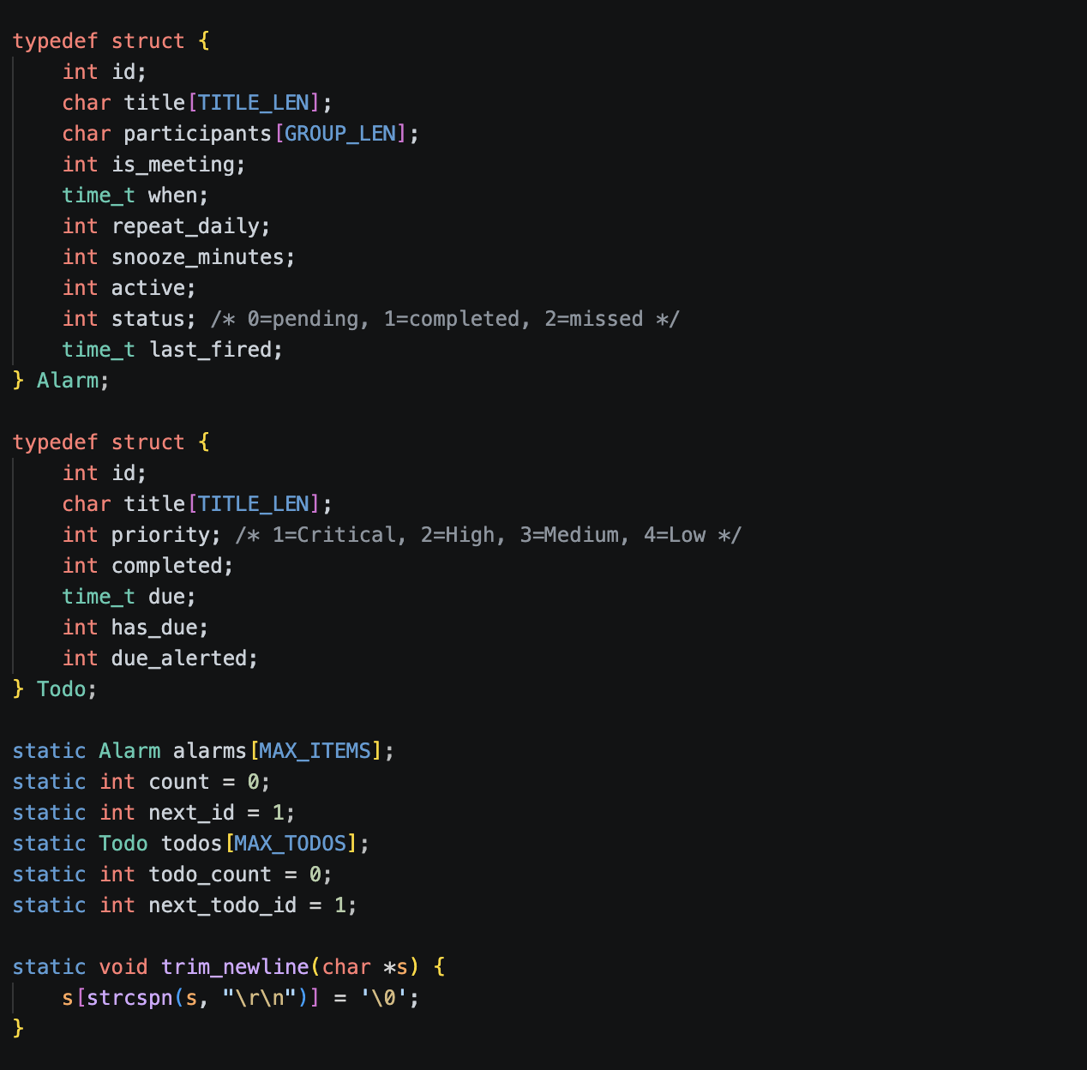
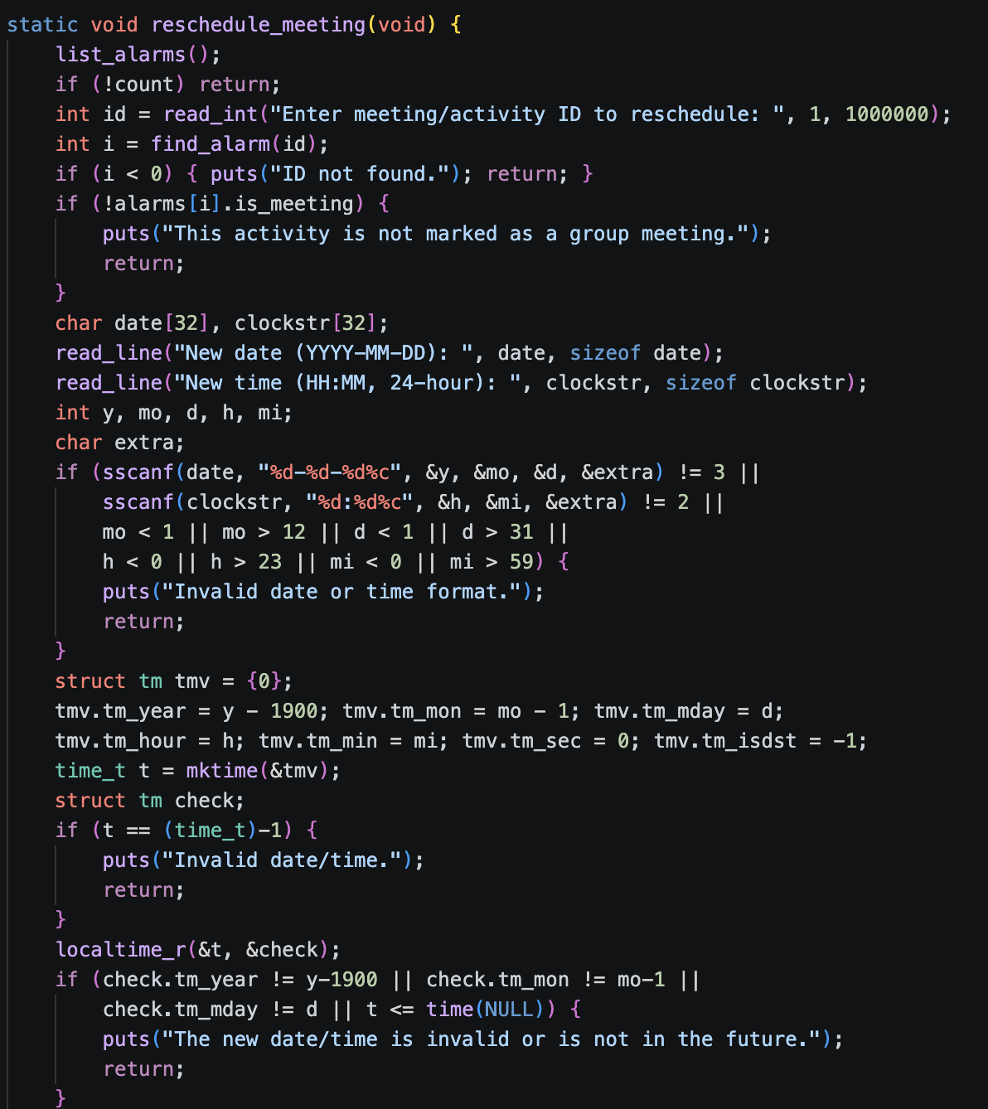
IMPLEMENTATION

Slide 11
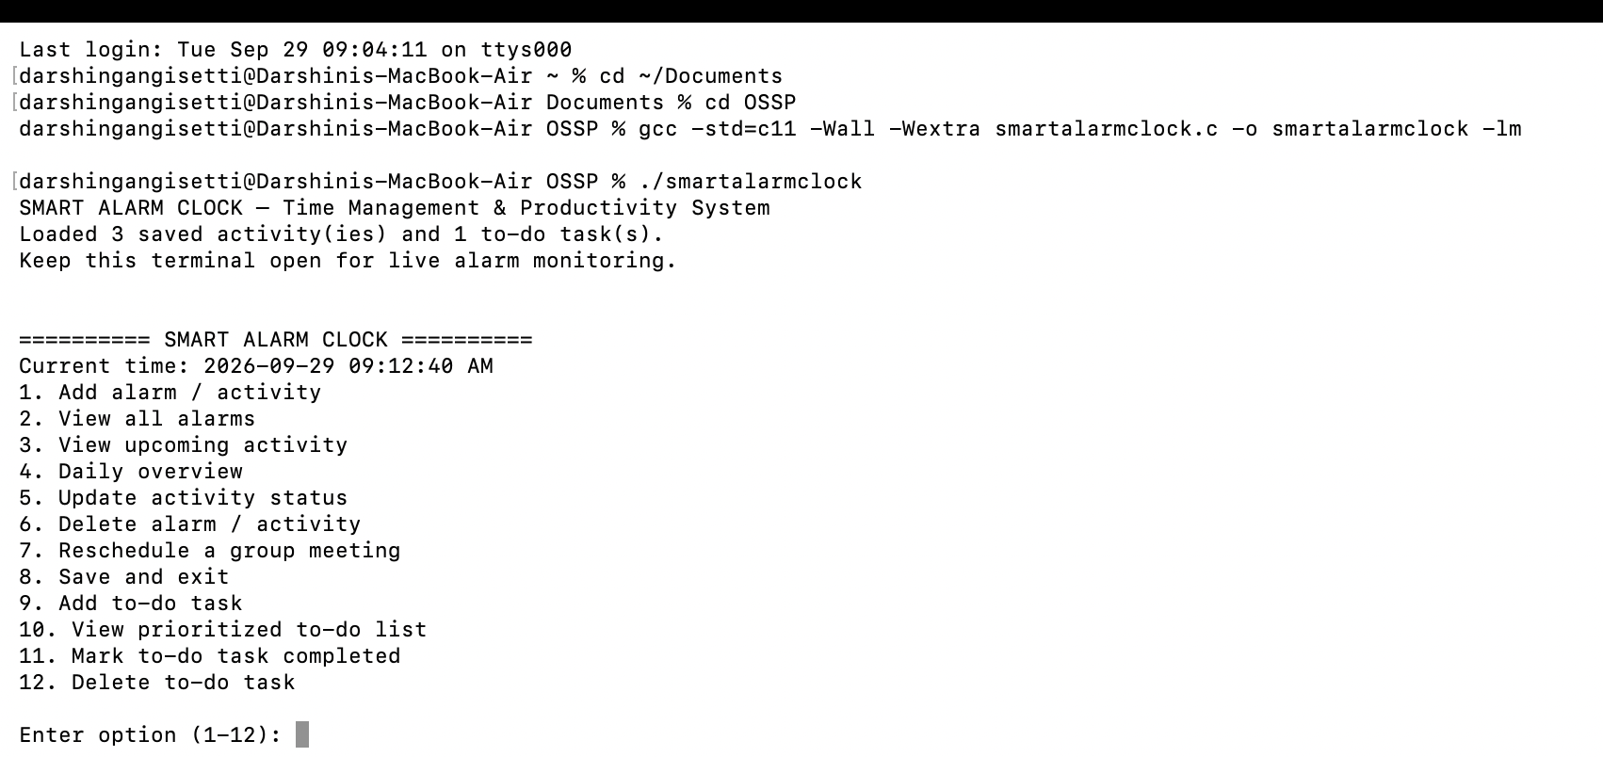
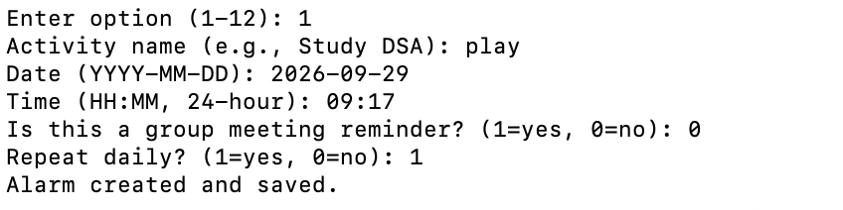
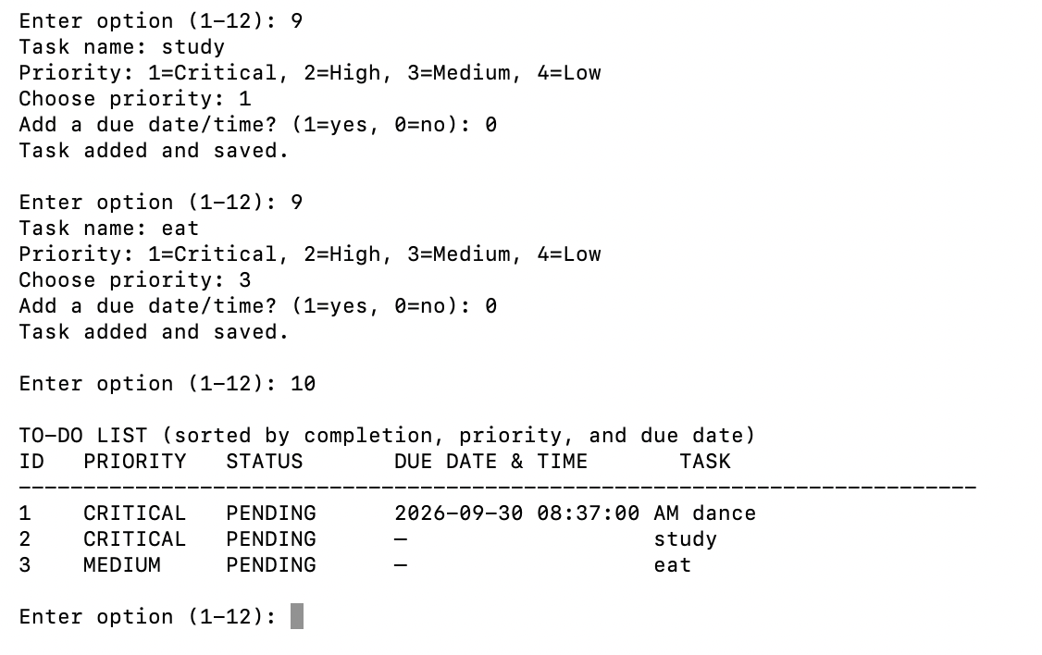
OUTPUT

Slide 12
Conclusion
The Smart Alarm Clock goes beyond a basic alarm by connecting alarms with daily activities, tasks, schedules, and reminders. It helps users organize their time and manage their daily activities more effectively. The project also demonstrates the practical use of C programming, Linux, and POSIX system-programming concepts.

Slide 13
THANK YOU

